Slide 1



OPPORTUNITY REVIEW
WHA DIRECT TO EMPLOYER PLAN
Exploring a Western Health Alliance State-Wide Health Plan

Slide 2


Founded in 1979, headquartered in Indianapolis
Largest Independently-Owned Full-Service Third-Party Administrator
Specialize in Administration of Self-Funded Plans and Population Health Management​
Leader in the Direct-to-Employer Movement
We Know and Understand the Market
Experience Working with All Professional Teams: Agents, Networks, MGAs
The Key Family of Companies is a Vertically Integrated group of benefit related organizations
3,000+ Corporate Clients
3 Million Members under Management
700 Employees

Slide 3


MARKET LEADER
IN
PRIVATE LABELED
HEALTH PLANS
Louisville, KY
OneHealth Plan
Cincinnati, OH
TCH Optimal
Bentonville, AR
Northwest Health Plan
Knoxville, TN
East Tennessee Health Plan
Meridian, MS
Affinity Health Plan
Fort Myers, FL
Lee Health Care Partners

Slide 4


DIRECT-TO-EMPLOYER (DTE)
YOU Pick the Name of the Health Plan
YOU Determine the Fees Charged
YOU Practice the Medicine
YOU Receive the Profits
WE Make it Successful
Your Health Plan Focused on a Direct Relationship with Self-Funded Employers in Your Market

Slide 5
DIRECT-TO-EMPLOYER STRATEGY: ONLY AVAILABLE TO PREMIER HEALTH SYSTEMS
STRONG Brand Quality
EXTENSIVE Patient Access
AFFORDABLE Value Pricing
EXCELLENT Care Quality

Slide 6
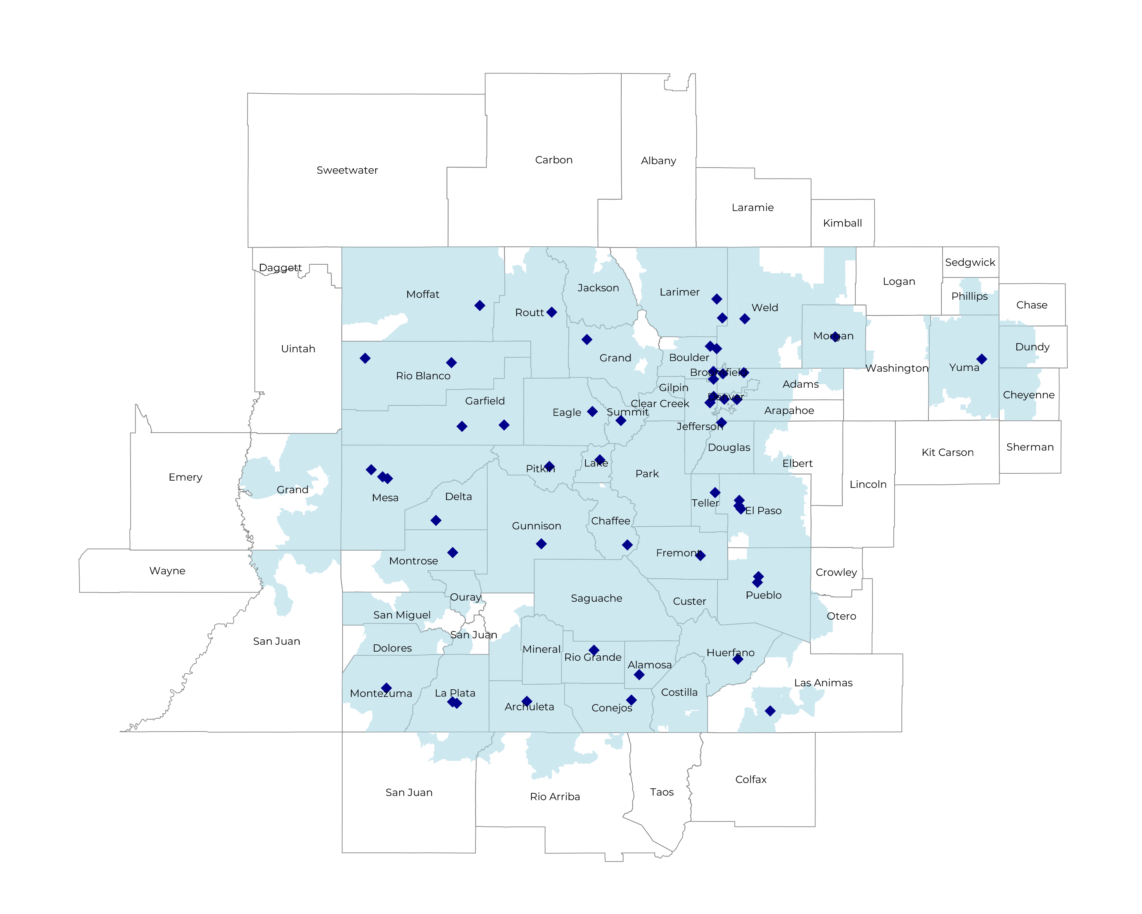
COVERING OVER 95% OF COLORADO’S POPULATION
Self Funded
1,371K
Insured
2,431K
Working Age
3,421K
Population
5,597K

Slide 7
WHA HOSPITALS ARE HIGH-QUALITY
4.1
WHA Hospitals
CMS Stars
Average CMS Quality Star Ratings
Other Colorado Hospitals
3.9
71
67
Mortality
National Percentile for Mortality Prevention
Patient Recommendation Rate
HCAHPS Patient Recommendation
National Percentile
60.2
59.1
74
Readmissions
National Percentile for Readmission Prevention
67

Slide 8
SIGNIFICANT OPPORTUNITY FOR PLAN GROWTH Researched for the below highlighted service area
Target Market 8,000+ Employers 1.4M+ Employees 3.1M+ Members
 | Employer Size Group (# of Employees)
Commercial Employers With Headquarters | 50-100 | 101-200 | 201-400 | 401-1,000 | 1,001-3,000 | 3,000+
In Catchment Area | 4,495 | 1,915 | 1,143 | 605 | 216 | 121
Total Employees at Employers | 50-100 | 101-200 | 201-400 | 401-1,000 | 1,001-3,000 | 3,000+
Headquartered in Catchment Area | 337,100 | 287,300 | 342,900 | 423,500 | 432,000 | 726,000
Total Members with Employers | 50-100 | 101-200 | 201-400 | 401-1,000 | 1,001-3,000 | 3,000+
Headquartered in Catchment Area | 606,800 | 517,100 | 617,200 | 762,300 | 777,600 | 1,306,800

Slide 9
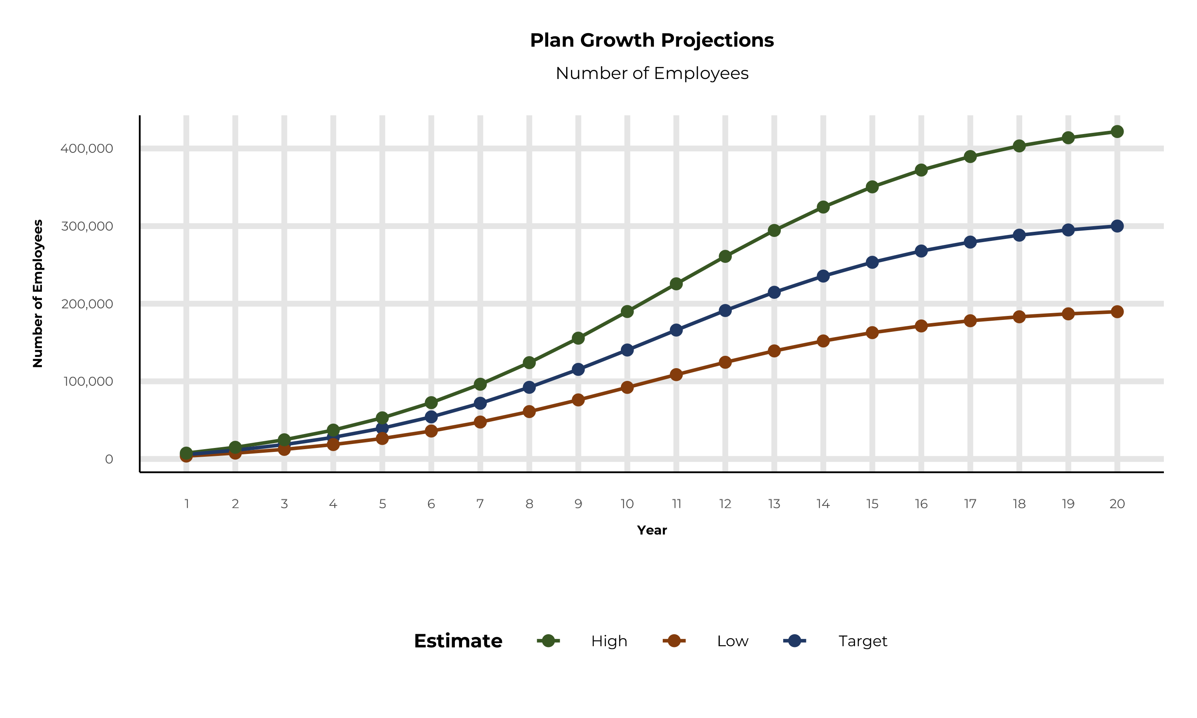
EXPECTED PLAN GROWTH
Year | Employees | Members
1 | 5,600 | 10,100
2 | 11,200 | 20,200
3 | 18,500 | 33,300
4 | 27,800 | 50,000
5 | 39,600 | 71,300
6 | 54,200 | 97,600
7 | 71,800 | 129,200
8 | 92,300 | 166,100
9 | 115,400 | 207,700
10 | 140,400 | 252,700
11 | 166,000 | 298,800
12 | 191,200 | 344,200
13 | 214,700 | 386,500
14 | 235,600 | 424,100
15 | 253,400 | 456,100
16 | 267,900 | 482,200
17 | 279,400 | 502,900
18 | 288,300 | 518,900
19 | 295,000 | 531,000
20 | 300,100 | 540,200
KBA currently estimates that Western Health Alliance has 47% inpatient market share, and 31% outpatient market compared to hospitals/clinics in the Western Health Alliance service area.
A WHA plan could expect patient steerage rates above 85% (comparable to other DTE plans), nearly double of current patient volumes.

Slide 10
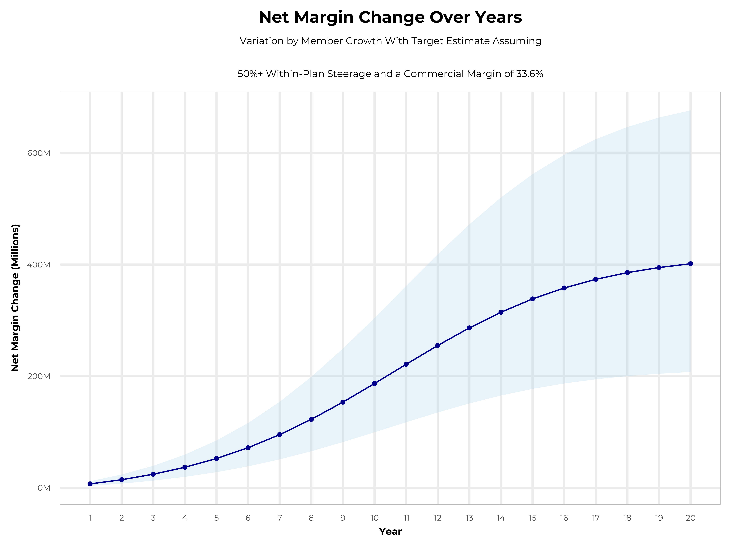
ENORMOUS POTENTIAL PROFITABILITY GROWTH FOR WHA MEMBERS
Early Stage
Gaining Name Recognition, Early Growth
New Revenue:
New Profit:
$125.19M
$34.47M
Growth Stage
Strong Reputation, Strong Growth
New Revenue:
New Profit:
$681.98M
$188.72M
Mature Stage
High Profitability, Market Saturation
New Revenue:
New Profit:
$1324.4M
$366.64M
See Extended Slide Deck for Details on Financial Modeling

Slide 11





A PARTNER YOU CAN TRUST
OUR OBJECTIVES ARE ALIGNED
WE KNOW THE
MARKET
COMPLETELY TRANSPARENT
WE HAVE THE SOPHISTICATION AND INFRASTRUCTURE TO EFFECTIVELY COMPETE
Derek Moore, Senior Vice President – KBA
845-283-9973 * derek.moore@keybenefit.com

